Slide 1
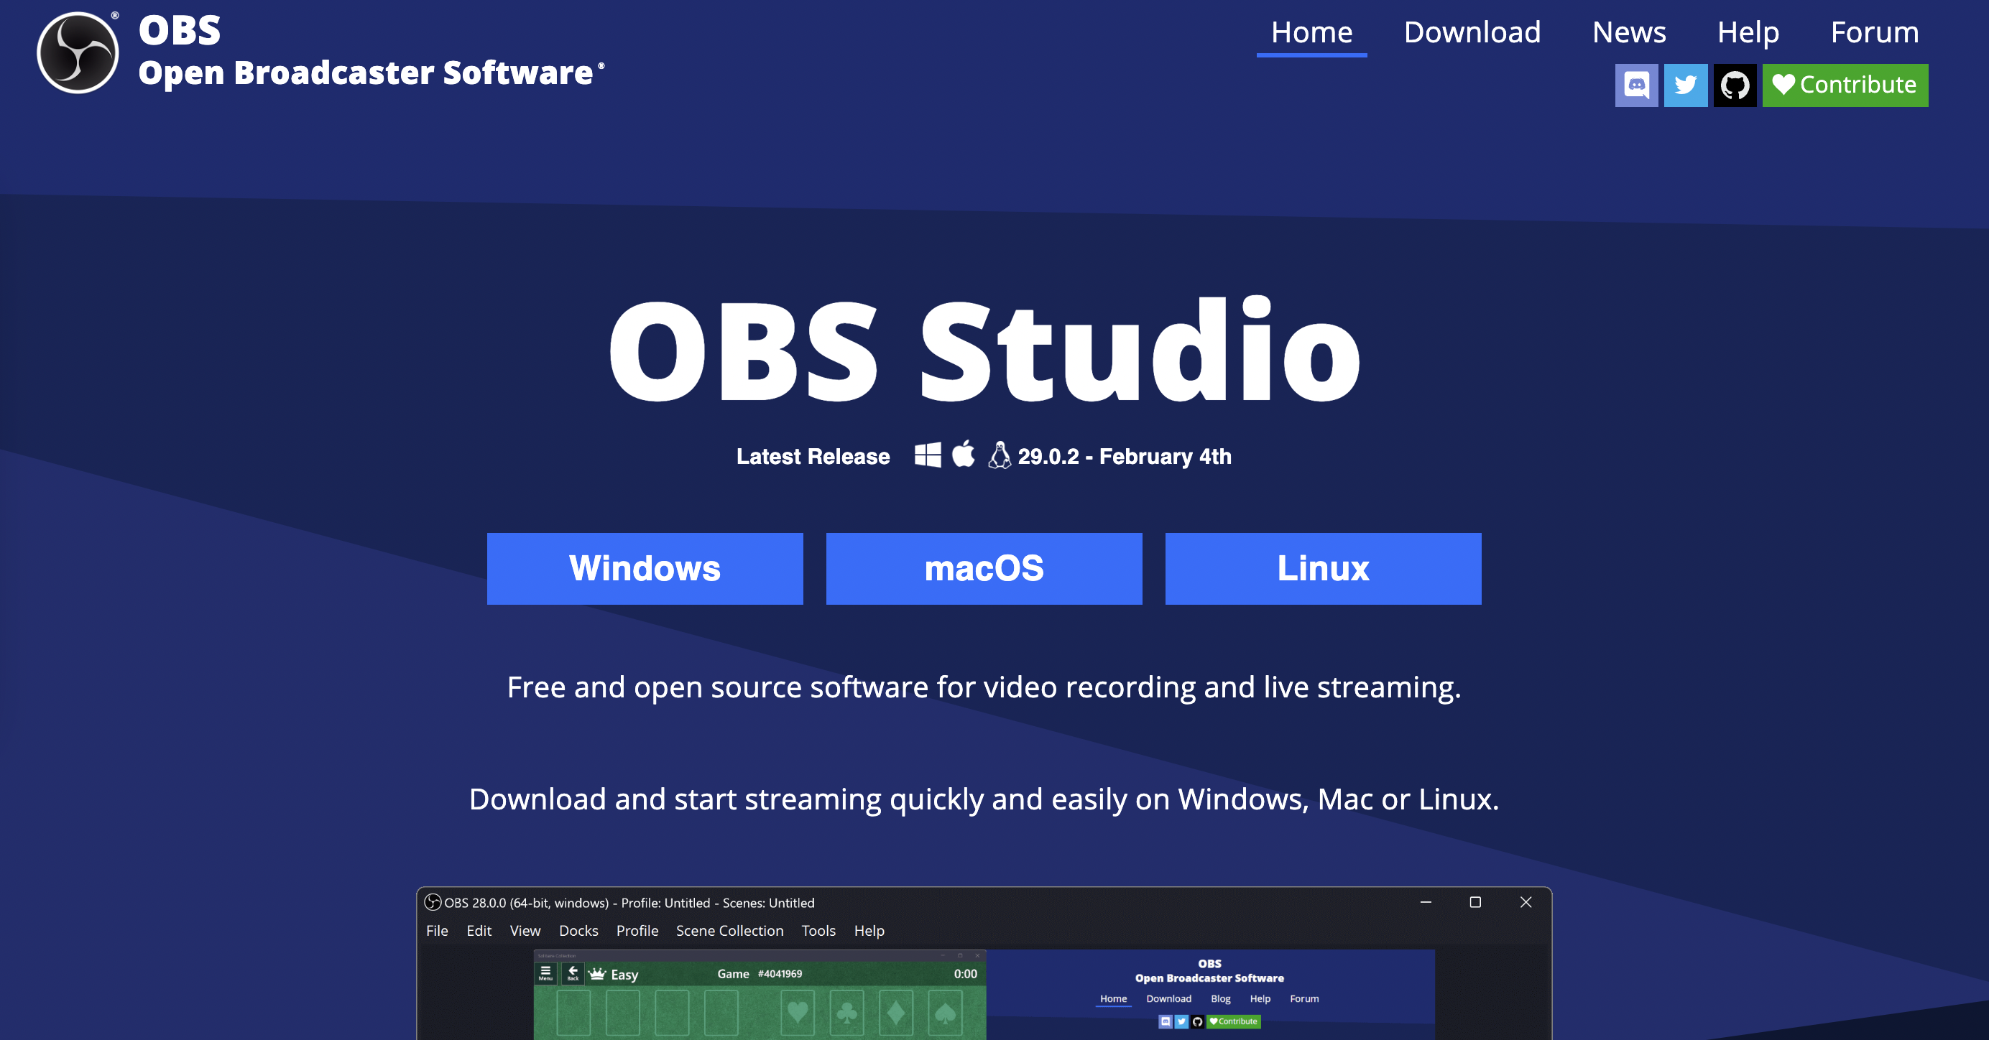
Download OBS: www.obsproject.com
Notes:
Install OBS: First, download and install OBS on your computer from the official OBS website.

Slide 2
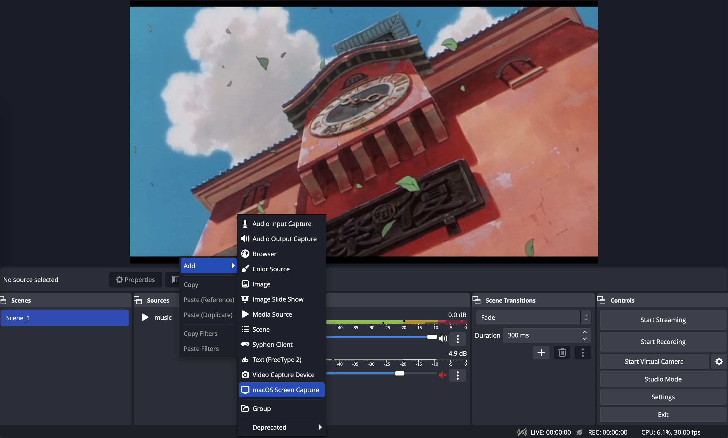
Notes:
Create a new scene: Open OBS and click the "+" button in the "Scenes" section to create a new scene. You can add different sources to this scene such as game capture, display capture, webcam, audio input, etc.

Slide 3
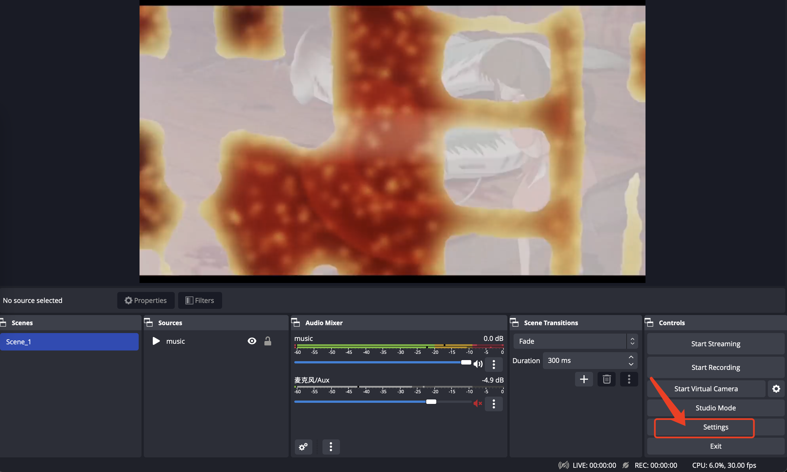
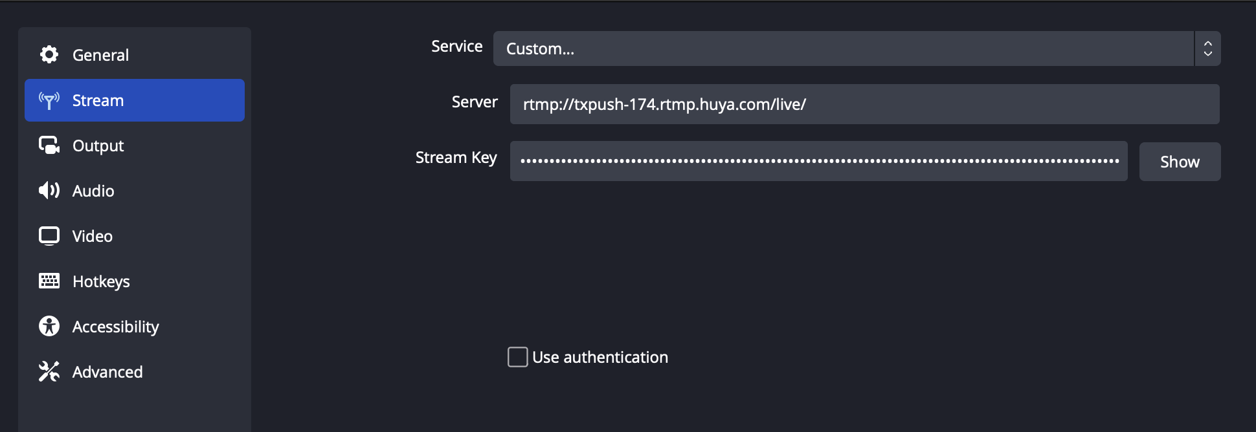
Setup Stream URL
Notes:
Set up streaming output: Click on the "Settings" button at the bottom right corner of OBS and go to the "Stream" tab. Choose your preferred streaming platform and enter your stream key or URL. You can also adjust the bitrate, resolution, and other streaming settings based on your internet connection.

Slide 4
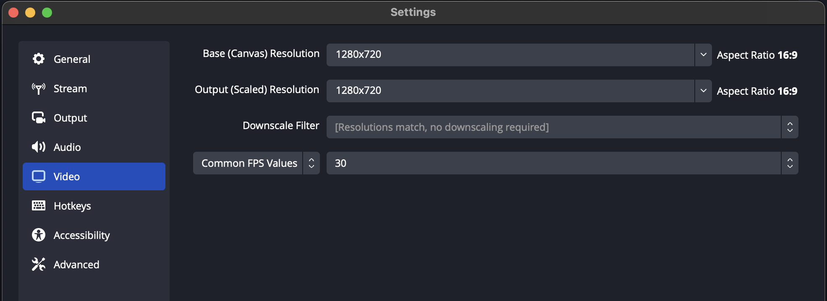
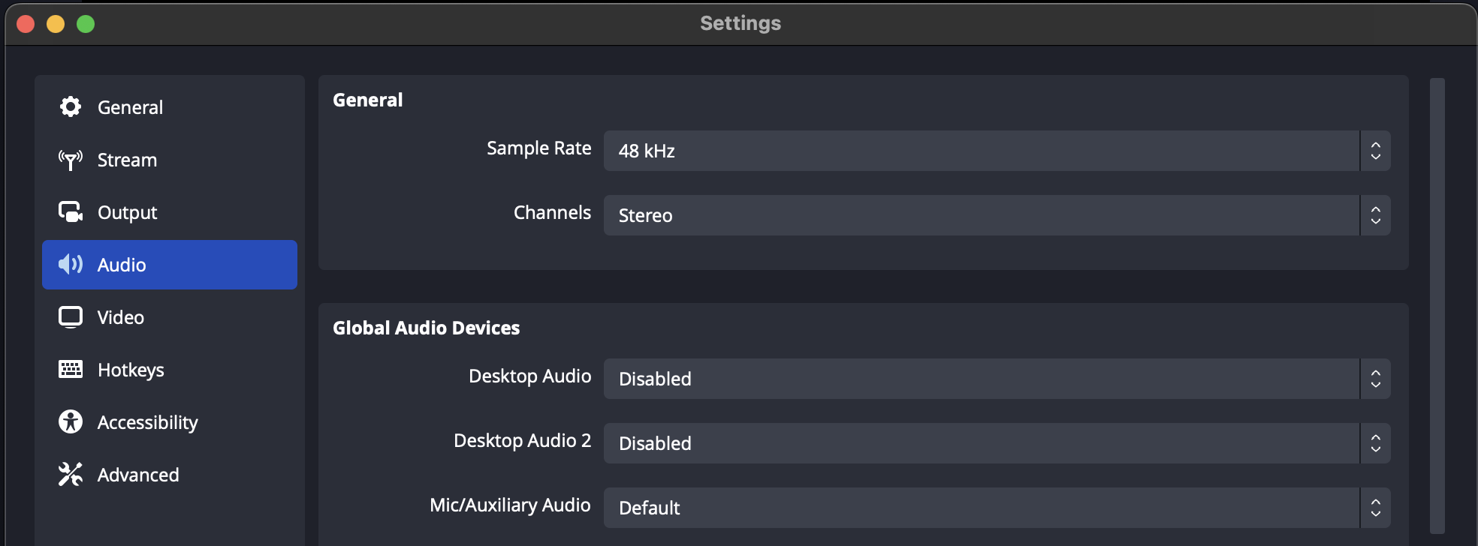
Video&Audio Settings
default settings is good
Notes:
Configure video and audio settings: In the "Video" tab of the "Settings" menu, choose your preferred resolution and FPS. In the "Audio" tab, select your microphone and audio output device.

Slide 5
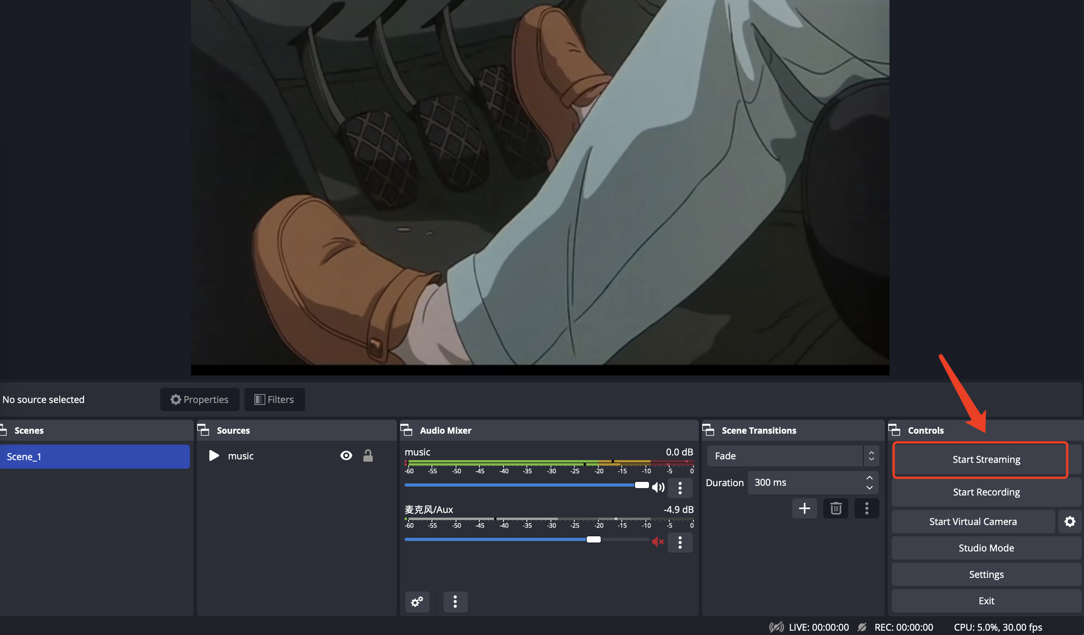
Notes:
If everything looks good, click the "Start Streaming" button to begin your live stream.

